Slide 1

NASHVILE CITY CEMTREY PROJECT
FOZEYA ALKADER
09/15/23

Slide 2
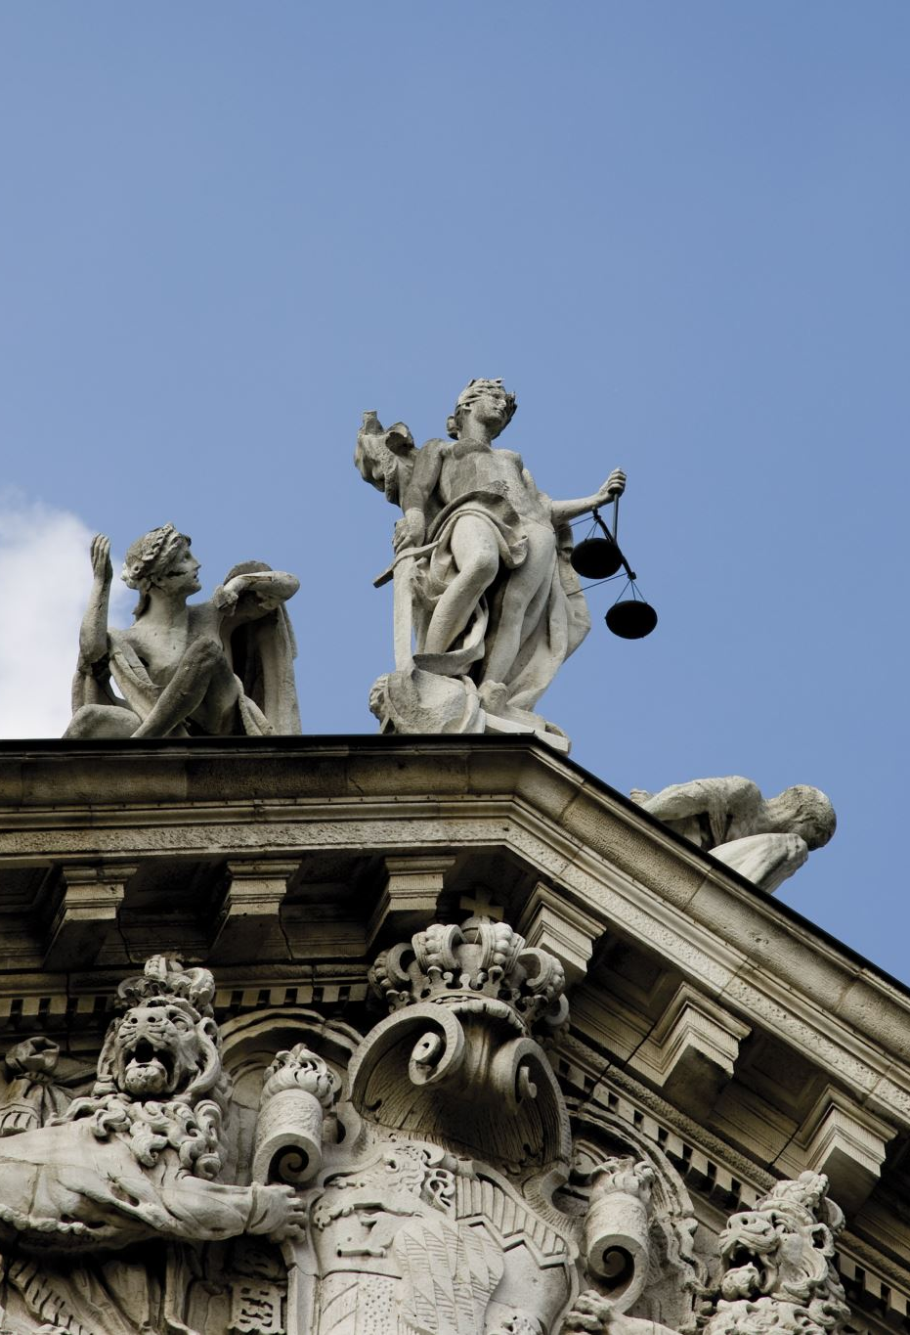
Introduction
Nashville City Cemetery is the oldest public cemetery since 1822.
It gives a burial/death service without discrimination of sex or race.
It is also one of the historical and recreational place.

Slide 3
Why the number burial/death escalate on a certain time?
Civil war was one of the major reasons
In 1864 ,the highest number of people died.

Slide 4
As we see in month:
June and July had the highest
January and February had the lowest records.

Slide 5
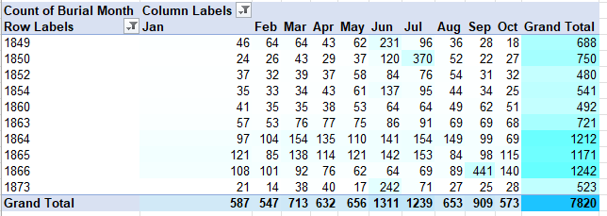
The number of deaths per year per month

Slide 6
The other cause to increase the number of death was disease and sickness
22% of the total cause of death/burial is consumption
Was higher in 1866

Slide 7
Finally…
As the year in progress, the number of death decreased.

